Slide 1
RUSTikales Rust for beginners

Slide 2
Plan for today
Recap
Ownership
Borrow Checker

Slide 3
Recap
Primitive Types in Rust: i8, u8, ..., i128, u128, bool

Slide 4
Recap
Primitive Types in Rust: i8, u8, ..., i128, u128, bool
let → immutable variable
let mut → mutable variable

Slide 5
Recap
Primitive Types in Rust: i8, u8, ..., i128, u128, bool
let → immutable variable
let mut → mutable variable
Arrays: [type; size]
Vectors: Vec<type>
var[index] to access an element at a given index

Slide 6
Recap
Primitive Types in Rust: i8, u8, ..., i128, u128, bool
let → immutable variable
let mut → mutable variable
Arrays: [type; size]
Vectors: Vec<type>
var[index] to access an element at a given index
loop {} to create an infinite loop
while condition {} to create a conditional loop
for elem in collection {} to create an iterator over a collection

Slide 7
Recap
Primitive Types in Rust: i8, u8, ..., i128, u128, bool
let → immutable variable
let mut → mutable variable
Arrays: [type; size]
Vectors: Vec<type>
var[index] to access an element at a given index
loop {} to create an infinite loop
while condition {} to create a conditional loop
for elem in collection {} to create an iterator over a collection
loop, while and for are equally powerful, but often certain loops are better
Infinite loops using for is convoluted
Iterating over a collection with loop is a lot of work

Slide 8
Recap
Important to know:
for n in x..y → n stops before y
for n in x..=y → n includes y

Slide 9
Recap
Important to know:
for n in x..y → n stops before y
for n in x..=y → n includes y
use break to exit out of a loop early

Slide 10
Recap
Important to know:
for n in x..y → n stops before y
for n in x..=y → n includes y
use break to exit out of a loop early
use continue to skip one loop pass

Slide 11
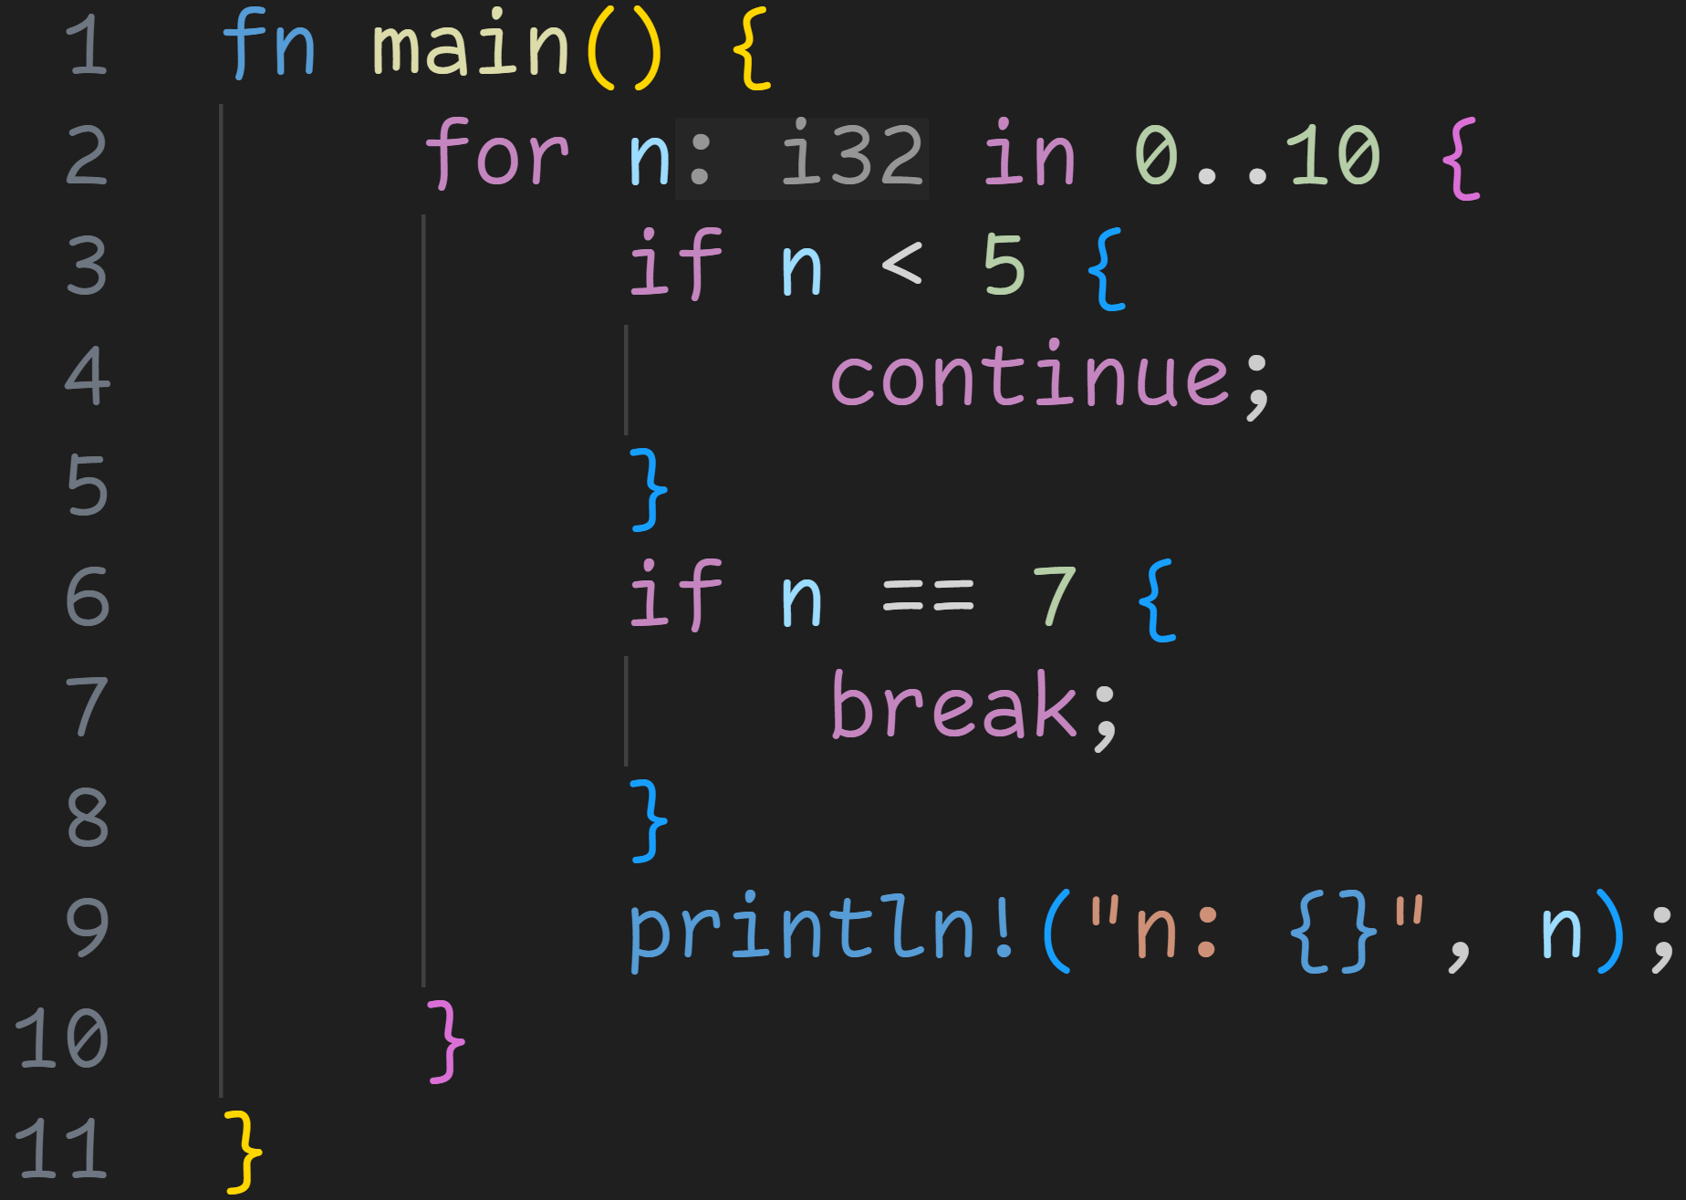
Recap

Slide 12
Recap
Jump to line 2 if n is less than 5

Slide 13
Recap
Jump to line 10 if n is equal to 7

Slide 14
Recap
1/3
What do we print in the console?

Slide 15
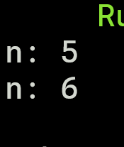
Recap
1/3
What do we print in the console?

Slide 16
Recap
Important to know:
for n in x..y → n stops before y
for n in x..=y → n includes y
use break to exit out of a loop early
use continue to skip one loop pass

Slide 17
Recap
Important to know:
for n in x..y → n stops before y
for n in x..=y → n includes y
use break to exit out of a loop early
use continue to skip one loop pass
you can nest loops
Nesting means putting a structure inside itself
Similar to nested arrays

Slide 18
Recap
Important to know:
for n in x..y → n stops before y
for n in x..=y → n includes y
use break to exit out of a loop early
use continue to skip one loop pass
you can nest loops
Loops allow us to control the flow of the program
We can now implement simple algorithms, such as:
The factorial of a number → n!
Primality test → Is n a prime?

Slide 19
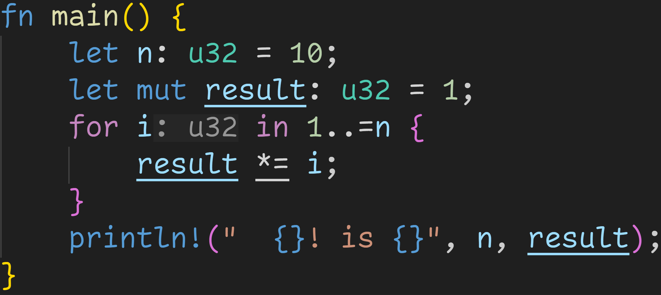
Recap
n! = n * (n – 1) * (n – 2) * ... * 2 * 1

Slide 20
Recap
n! = n * (n – 1) * (n – 2) * ... * 2 * 1

Slide 21
Recap
n! = n * (n – 1) * (n – 2) * ... * 2 * 1

Slide 22

Recap
n! = n * (n – 1) * (n – 2) * ... * 2 * 1

Slide 23
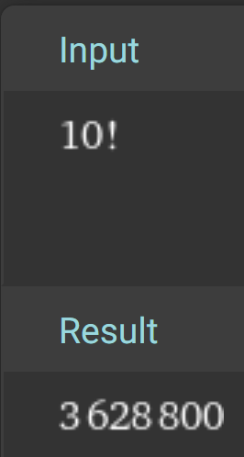
Recap
WolframAlpha:

Slide 24
Ownership

Slide 25
Ownership
Last time: Using a Vector in a for-loop made the variable invalid after the loop

Slide 26
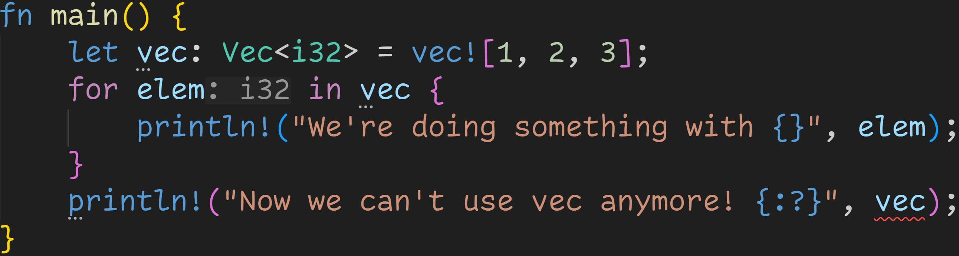
Ownership
Last time: Using a Vector in a for-loop made the variable invalid after the loop

Slide 27
Ownership
Last time: Using a Vector in a for-loop made the variable invalid after the loop
red wiggly lines are never good!

Slide 28
Ownership
Last time: Using a Vector in a for-loop made the variable invalid after the loop
Dots mean the mistake lies here
red wiggly lines are never good!

Slide 29
Ownership
Last time: Using a Vector in a for-loop made the variable invalid after the loop
Let‘s take a closer look at the error

Slide 30
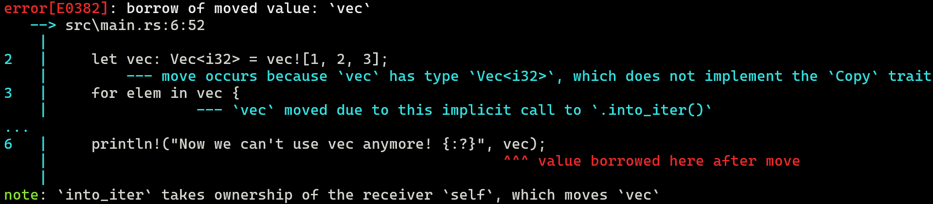
Ownership
Last time: Using a Vector in a for-loop made the variable invalid after the loop
Let‘s take a closer look at the error

Slide 31
Ownership
Last time: Using a Vector in a for-loop made the variable invalid after the loop
Let‘s take a closer look at the error
A lot of words, let‘s focus on the important bits

Slide 32
Ownership
Last time: Using a Vector in a for-loop made the variable invalid after the loop
Let‘s take a closer look at the error
A lot of words, let‘s focus on the important bits

Slide 33
Ownership
Last time: Using a Vector in a for-loop made the variable invalid after the loop
Let‘s take a closer look at the error
A lot of words, let‘s focus on the important bits,
boiling it down even more

Slide 34
Ownership
Last time: Using a Vector in a for-loop made the variable invalid after the loop
Let‘s take a closer look at the error
Error boiled down to three keywords:
Borrowed
Moved
Ownership

Slide 35
Ownership
Last time: Using a Vector in a for-loop made the variable invalid after the loop
Let‘s take a closer look at the error
Error boiled down to three keywords:
Borrowed
Moved
Ownership
Today, we‘ll dive deep down into the world of Rust

Slide 36
Ownership
At some point, every compiler constructor has to address the elephant in the room: Memory Management
How do you handle data structures, how do you handle heap allocations, etcetc

Slide 37
Ownership
The elephant in the room: Memory Management
How do you handle data structures, how do you handle heap allocations, etcetc
Many different techniques exist

Slide 38
Ownership
The elephant in the room: Memory Management
How do you handle data structures, how do you handle heap allocations, etcetc
Many different techniques exist
Manual Management, like in C or Assembly

Slide 39
Ownership
The elephant in the room: Memory Management
How do you handle data structures, how do you handle heap allocations, etcetc
Many different techniques exist
Manual Management, like in C or Assembly
Garbage Collection, like in Java or Python

Slide 40
Ownership
The elephant in the room: Memory Management
How do you handle data structures, how do you handle heap allocations, etcetc
Many different techniques exist
Manual Management, like in C or Assembly
Garbage Collection, like in Java or Python
Automatic Reference Counting, like in Swift

Slide 41
Ownership
The elephant in the room: Memory Management
How do you handle data structures, how do you handle heap allocations, etcetc
Many different techniques exist
Manual Management, like in C or Assembly
Garbage Collection, like in Java or Python
Automatic Reference Counting, like in Swift
Ownership-Model, like in Rust or... Well, so far only Rust has really pulled it off (and maybe C++)

Slide 42
Ownership
The elephant in the room: Memory Management
How do you handle data structures, how do you handle heap allocations, etcetc
Many different techniques exist
The Ownership-Model is the technique used in Rust, it controls everything

Slide 43
Ownership
The elephant in the room: Memory Management
How do you handle data structures, how do you handle heap allocations, etcetc
Many different techniques exist
The Ownership-Model is the technique used in Rust, it controls everything
Set of rules

Slide 44
Ownership
The elephant in the room: Memory Management
How do you handle data structures, how do you handle heap allocations, etcetc
Many different techniques exist
The Ownership-Model is the technique used in Rust, it controls everything
Set of rules
Each value has an owner
Your 5 on the stack has an owner
Your elements on the heap have an owner

Slide 45
Ownership
The elephant in the room: Memory Management
How do you handle data structures, how do you handle heap allocations, etcetc
Many different techniques exist
The Ownership-Model is the technique used in Rust, it controls everything
Set of rules
Each value has an owner
There can only be exactly one owner at any given time
This is related to the Vector-problem we faced earlier

Slide 46
Ownership
The elephant in the room: Memory Management
How do you handle data structures, how do you handle heap allocations, etcetc
Many different techniques exist
The Ownership-Model is the technique used in Rust, it controls everything
Set of rules
Each value has an owner
There can only be exactly one owner at any given time
When the owner is dropped, the value is dropped (memory is freed)

Slide 47
Ownership
The elephant in the room: Memory Management
How do you handle data structures, how do you handle heap allocations, etcetc
Many different techniques exist
The Ownership-Model is the technique used in Rust, it controls everything
Set of rules
Each value has an owner
There can only be exactly one owner at any given time
When the owner is dropped, the value is dropped (memory is freed)
Almost always initiated by a variable going out of scope
Drop is recursive
Scope drops variable → variable drops Vector → Vector drops elements, which can drop other things

Slide 48
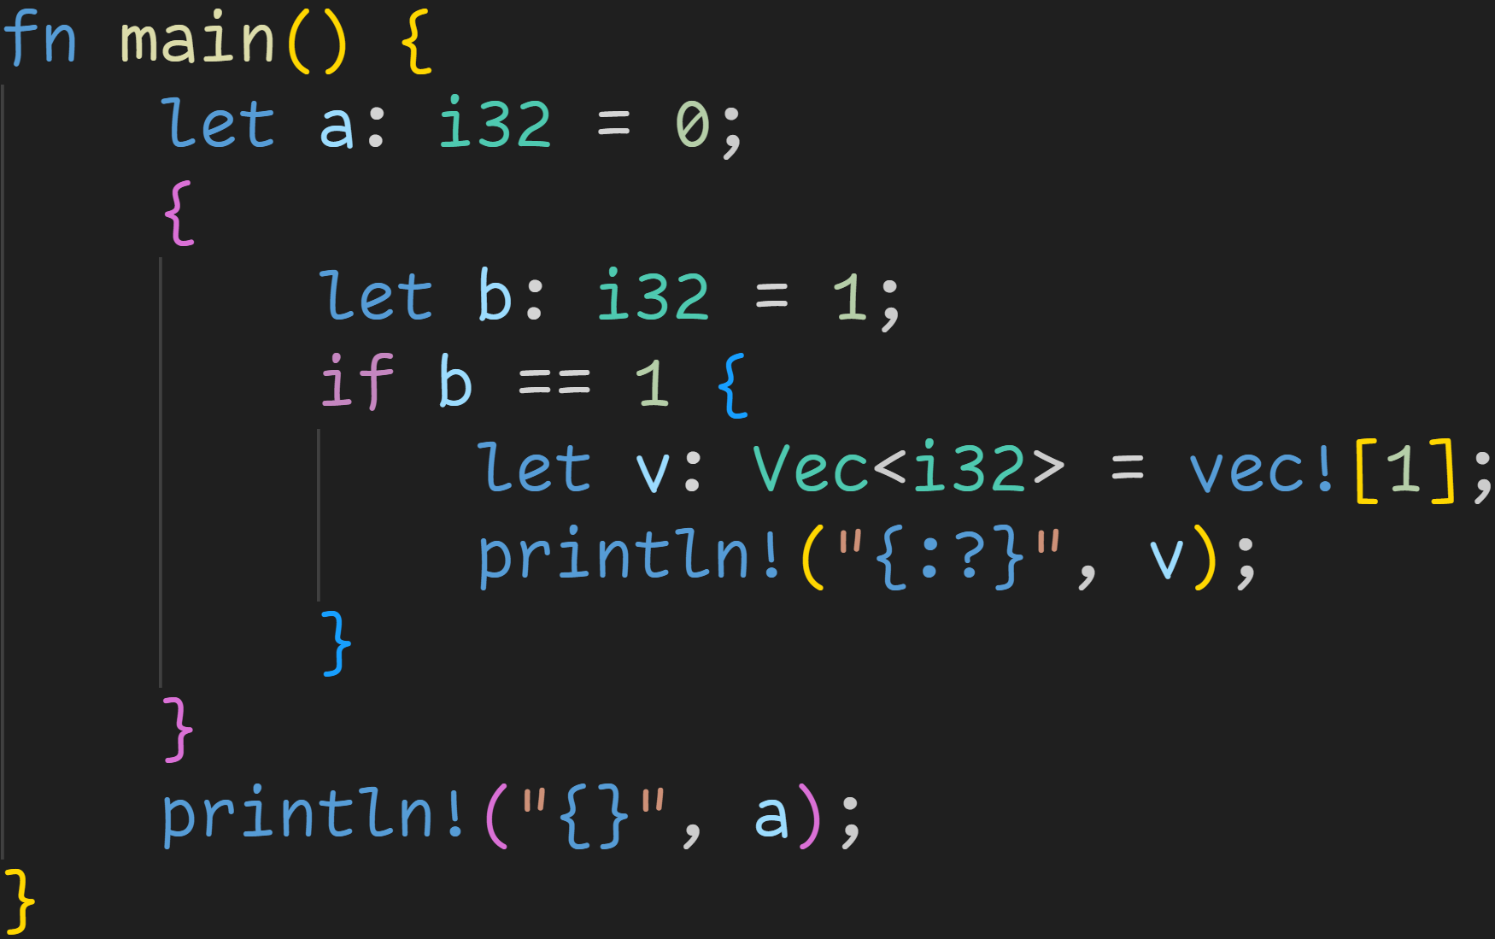
Ownership

Slide 49
Ownership
v dropped here → Vector dropped here → Vector elements dropped here

Slide 50
Ownership
v dropped here → Vector dropped here → Vector elements dropped here
b dropped here → Value 1 dropped here

Slide 51
Ownership
v dropped here → Vector dropped here → Vector elements dropped here
b dropped here → Value 1 dropped here
a dropped here → Value 0 dropped here

Slide 52
Ownership
Ownership-Conflicts are resolved by moving or copying the data

Slide 53
Ownership
Ownership-Conflicts are resolved by moving or copying the data
Whether a value is copied or moved is based on the trait system

Slide 54
Ownership
Ownership-Conflicts are resolved by moving or copying the data
Whether a value is copied or moved is based on the trait system
Types implementing the Copy-trait are copied
Otherwise, they are moved

Slide 55
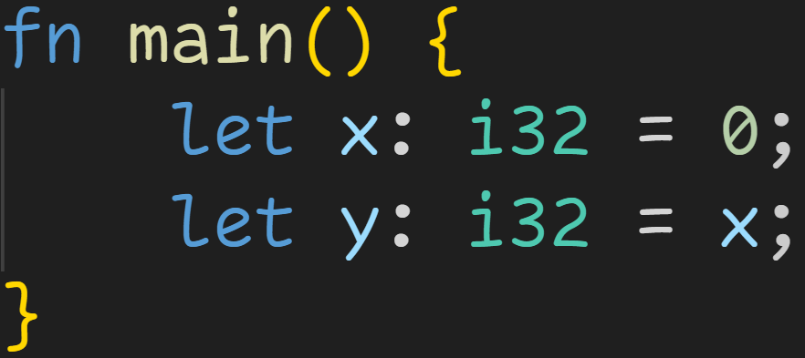
Ownership

Slide 56
Ownership
i32 is a simple primitive type that implements the Copy-trait
→ Value 0 is copied, we can still use x after assigning to y

Slide 57
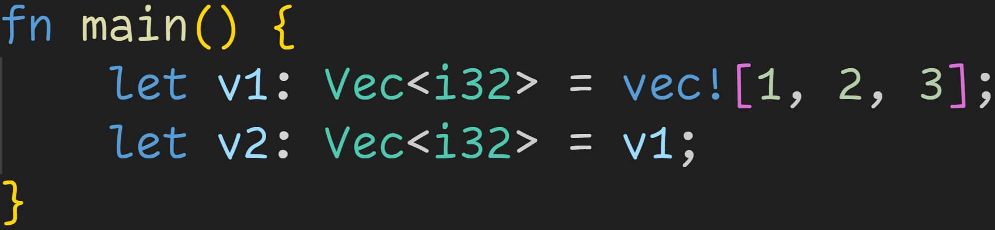
Ownership

Slide 58
Ownership
Vec<T> does not implement the Copy-trait:
→ Vec is generic, meaning we can put any type in it → But we can‘t guarantee that we can copy every type we put in there!

Slide 59
Ownership
Vec<T> does not implement the Copy-trait:
→ Vec is generic, meaning we can put any type in it → But we can‘t guarantee that we can copy every type we put in there!
However, we still copy some data

Slide 60
Ownership
Vector is a bit more complex: The data itself is located on the Heap, there‘s only Metadata on the Stack:
→ Pointer to the Heap
→ Length of Vector
→ Capacity of Vector

Slide 61
Ownership
Stack
ptr
len | 3
capacity | 4

Slide 62
Ownership
Stack
ptr | 0x1000
len | 3
capacity | 4
Heap
0x1000 | 1
0x1004 | 2
0x1008 | 3
0x100C | 90123987

Slide 63
Ownership
Even if values are moved, the data on the stack is still copied!
Stack
ptr | 0x1000
len | 3
capacity | 4
Heap
0x1000 | 1
0x1004 | 2
0x1008 | 3
0x100C | 90123987

Slide 64
Ownership
Stack
v1 | ptr | 0x1000
 | len | 3
 | capacity | 4
v2 | ptr | 0x1000
 | len | 3
 | capacity | 4
Heap
0x1000 | 1
0x1004 | 2
0x1008 | 3
0x100C | 90123987

Slide 65
Ownership
Stack
v1 | ptr | 0x1000
 | len | 3
 | capacity | 4
v2 | ptr | 0x1000
 | len | 3
 | capacity | 4
Heap
0x1000 | 1
0x1004 | 2
0x1008 | 3
0x100C | 90123987
This is very bad! v1 and v2 now point to the same heap location, and when dropped will both free the same memory!

Slide 66
Ownership
Stack
v1 | ptr | 0x1000
 | len | 3
 | capacity | 4
v2 | ptr | 0x1000
 | len | 3
 | capacity | 4
Heap
0x1000 | 1
0x1004 | 2
0x1008 | 3
0x100C | 90123987
This is very bad! v1 and v2 now point to the same heap location, and when dropped will both free the same memory!
Very bad for many reasons!

Slide 67
Ownership
Stack
v1 | ptr | 0x1000
 | len | 3
 | capacity | 4
v2 | ptr | 0x1000
 | len | 3
 | capacity | 4
Heap
0x1000 | 1
0x1004 | 2
0x1008 | 3
0x100C | 90123987
What does the compiler do?
It invalidates v1, and moves the data into v2

Slide 68
Ownership
Stack
v1 | ptr | ???
 | len | ???
 | capacity | ???
v2 | ptr | 0x1000
 | len | 3
 | capacity | 4
Heap
0x1000 | 1
0x1004 | 2
0x1008 | 3
0x100C | 90123987
What does the compiler do?
It invalidates v1, and moves the data into v2

Slide 69
Ownership
Stack
v1 | ptr | ???
 | len | ???
 | capacity | ???
v2 | ptr | 0x1000
 | len | 3
 | capacity | 4
Heap
0x1000 | 1
0x1004 | 2
0x1008 | 3
0x100C | 90123987
What does the compiler do?
It invalidates v1, and moves the data into v2
By doing that, the data on the heap will only be freed once, everything is fine!
Downside is that you can‘t use v1 anymore, until you re-assign a value to it.

Slide 70
Ownership
After the 2nd line, v1 was moved into v2 and can‘t be used anymore, until you re-assign to v1.

Slide 71
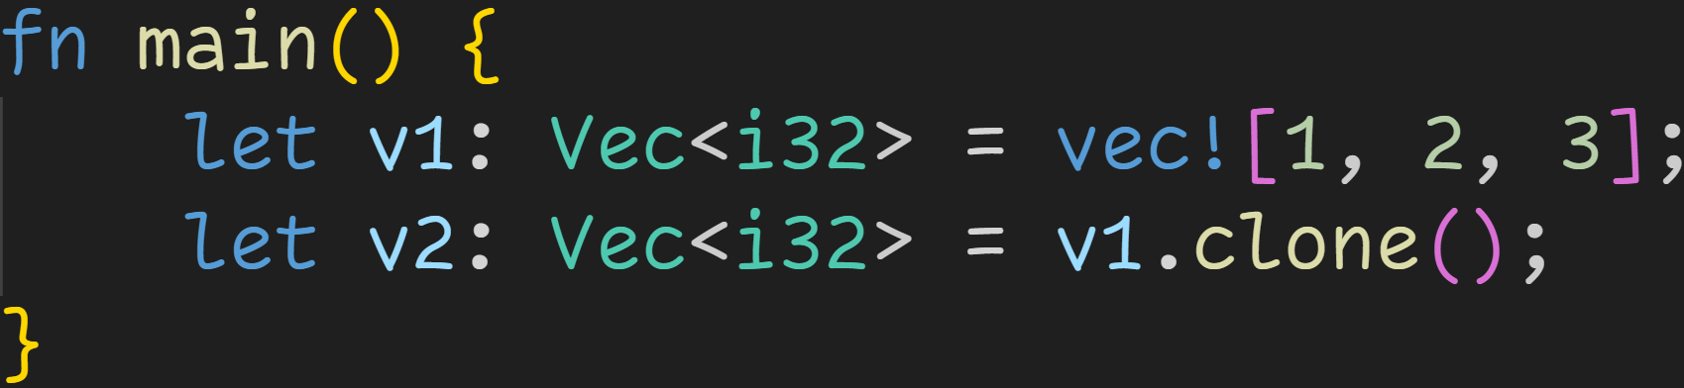
Ownership
We can still copy explicitly using .clone()

Slide 72
Ownership
We can still copy explicitly using .clone()
The Clone-trait implementation also clones the underlying elements, so everything is fine

Slide 73
Ownership
Let‘s go back to the Vector example:

Slide 74
Ownership
Let‘s go back to the Vector example:
We now understand that for moves the value

Slide 75
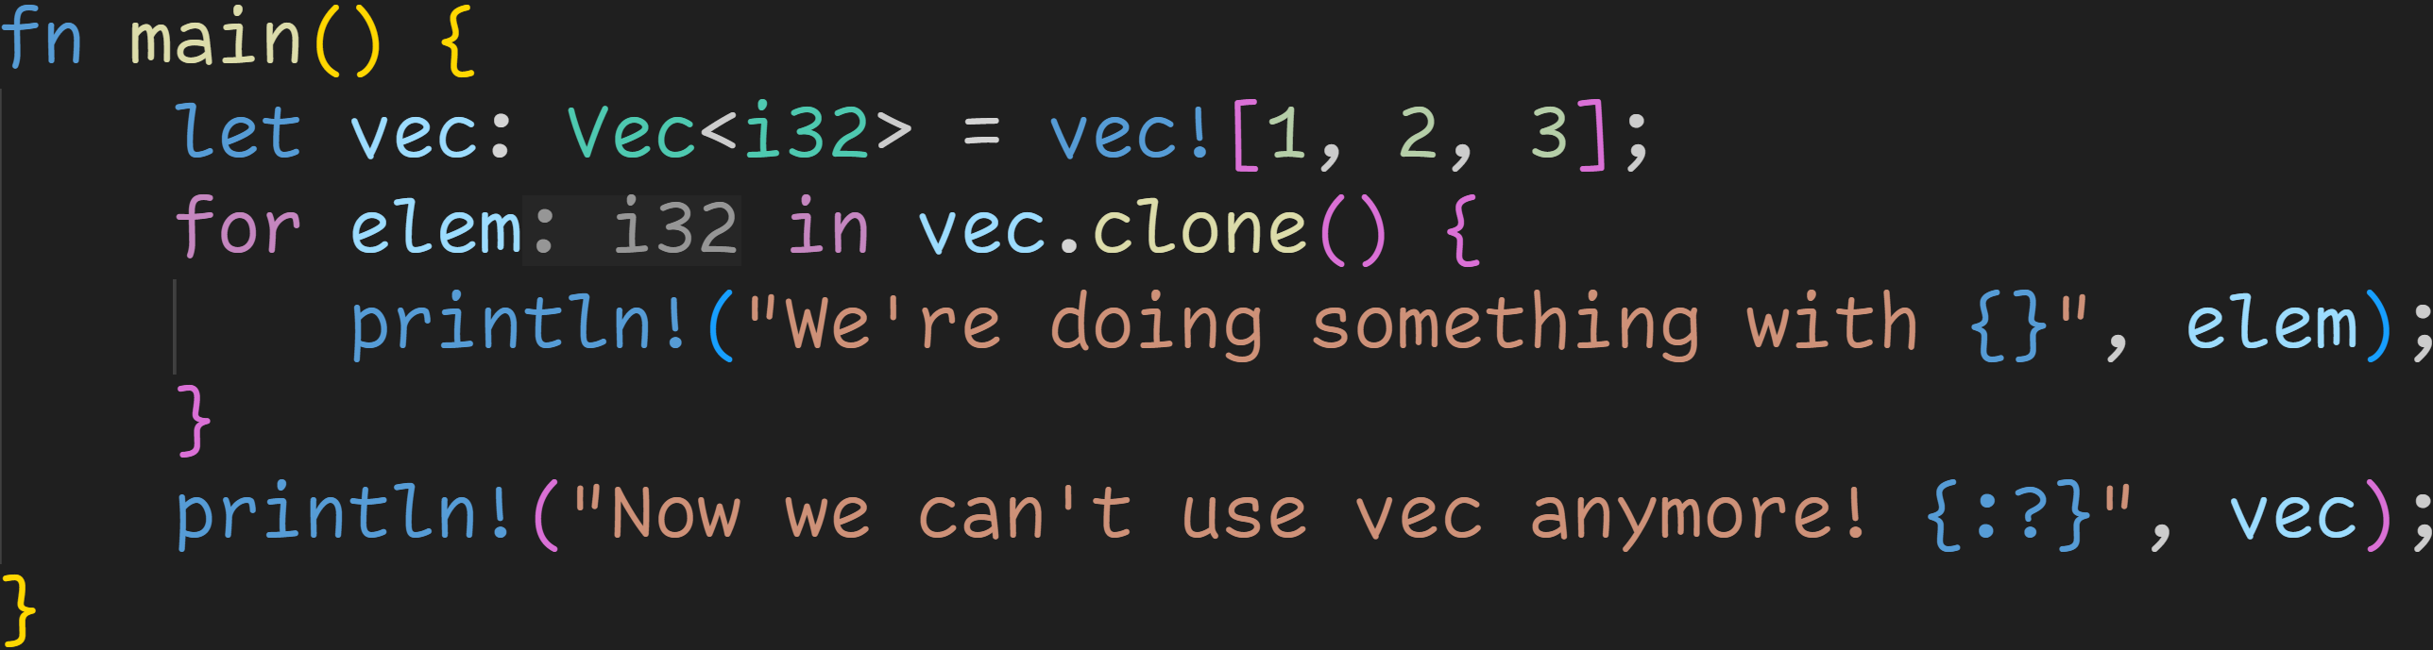
Ownership
Easy fix, clone it!!
Let‘s go back to the Vector example:

Slide 76

Ownership
Easy fix, clone it!?
Let‘s go back to the Vector example:

Slide 77
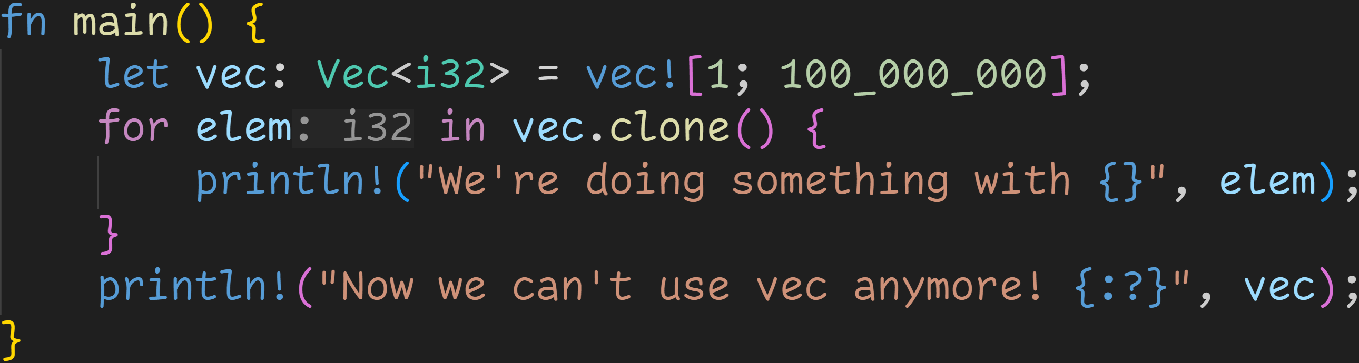
Ownership

Slide 78
Ownership
Cloning might take a while...

Slide 79

Ownership
Cloning might take a while...
Back to our original problem anyway!! We want to modify vec, not any copies of it!

Slide 80
Intermission - References
References offer an additional way of accessing values

Slide 81
Intermission - References
References offer an additional way of accessing values
References do not involve copying or moving, and do not invalidate original variables

Slide 82
Intermission - References
References offer an additional way of accessing values
References do not involve copying or moving, and do not invalidate original variables
A reference in programming is similar to a real life reference:

Slide 83
Intermission - References
References offer an additional way of accessing values
References do not involve copying or moving, and do not invalidate original variables
A reference in programming is similar to a real life reference:
When you‘re referring to something, you don‘t own it, but simply point to it

Slide 84
Intermission - References
References offer an additional way of accessing values
References do not involve copying or moving, and do not invalidate original variables
A reference in programming is similar to a real life reference:
When you‘re referring to something, you don‘t own it, but simply point to it
A reference in a book might point to another book, written by another author
That other book might change in the meantime, but the reference still points to it

Slide 85
Intermission - References
References offer an additional way of accessing values
References do not involve copying or moving, and do not invalidate original variables
A reference in programming is similar to a real life reference:
When you‘re referring to something, you don‘t own it, but simply point to it
A reference in a book might point to another book, written by another author
That other book might change in the meantime, but the reference still points to it
References in Rust do the same, they simply point to a value

Slide 86
Intermission - References
References offer an additional way of accessing values
References do not involve copying or moving, and do not invalidate original variables
A reference in programming is similar to a real life reference:
When you‘re referring to something, you don‘t own it, but simply point to it
A reference in a book might point to another book, written by another author
That other book might change in the meantime, but the reference still points to it
References in Rust do the same, they simply point to a value
In the context of Ownership, a reference is called borrowing:
„As in real life, if a person owns something, you can borrow it from them. When you‘re done, you have to give it back. You don‘t own it.“ – Rustdocs

Slide 87
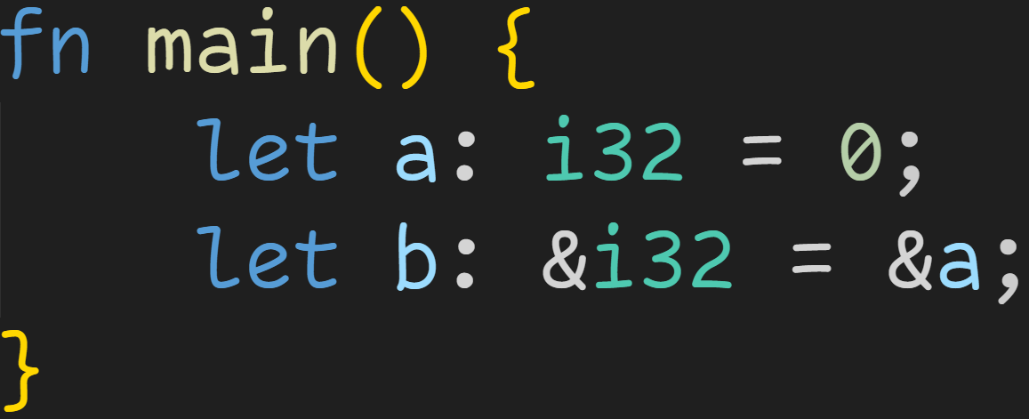
Intermission - References

Slide 88
Intermission - References
Reference to a

Slide 89
Intermission - References
Type: Reference to i32

Slide 90
Intermission - References
That means: b contains the memory address of a

Slide 91
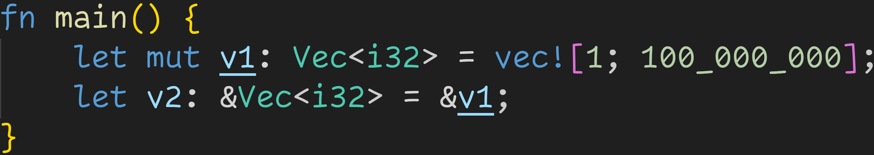
Intermission - References

Slide 92
Intermission - References
Reference to v1, no copy or move involved!
v1 is still valid after this line!

Slide 93
Intermission - References
Addr | Stack
0x4000 | v1 | ptr | 0x1000
 |  | len | 100_000_000
 |  | cap | 100_000_000
Heap
0x1000 | 1
0x1004 | 1
0x1008 | 1
... | ...

Slide 94
Intermission - References
Addr | Stack
0x4000 | v1 | ptr | 0x1000
 |  | len | 100_000_000
 |  | cap | 100_000_000
0x4020 | v2 | ptr | 0x4000
Heap
0x1000 | 1
0x1004 | 1
0x1008 | 1
... | ...

Slide 95
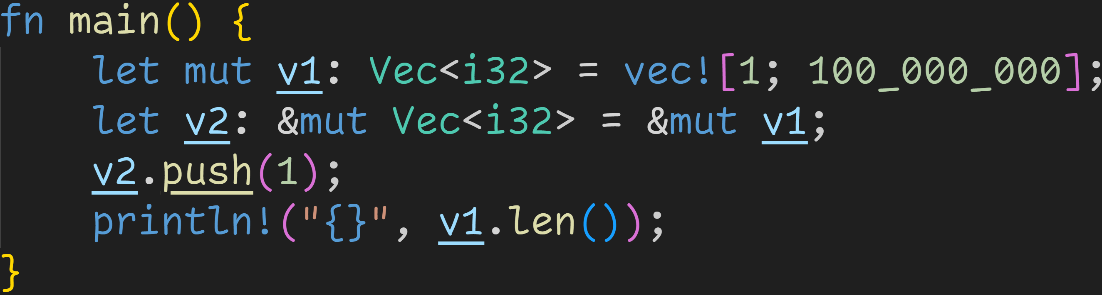
Intermission - References

Slide 96
Intermission - References
Mutable reference

Slide 97
Intermission - References
Pushing a value to a reference doesn‘t make sense
→ Rust automatically dereferences a reference if necessary

Slide 98
Intermission - References
Pushing a value to a reference doesn‘t make sense
→ Rust automatically dereferences a reference if necessary
→ This line pushes an element to v1

Slide 99

Intermission - References
Pushing a value to a reference doesn‘t make sense
→ Rust automatically dereferences a reference if necessary
→ This line pushes an element to v1

Slide 100
Borrow Checker

Slide 101
Borrow Checker
Rust is all about memory safety

Slide 102
Borrow Checker
Rust is all about memory safety
References are powerful, but can also lead to all sorts of bugs if not treated carefully

Slide 103
Borrow Checker
Rust is all about memory safety
References are powerful, but can also lead to all sorts of bugs if not treated carefully
Ask your local Java developer, he‘ll tell you a story or two

Slide 104
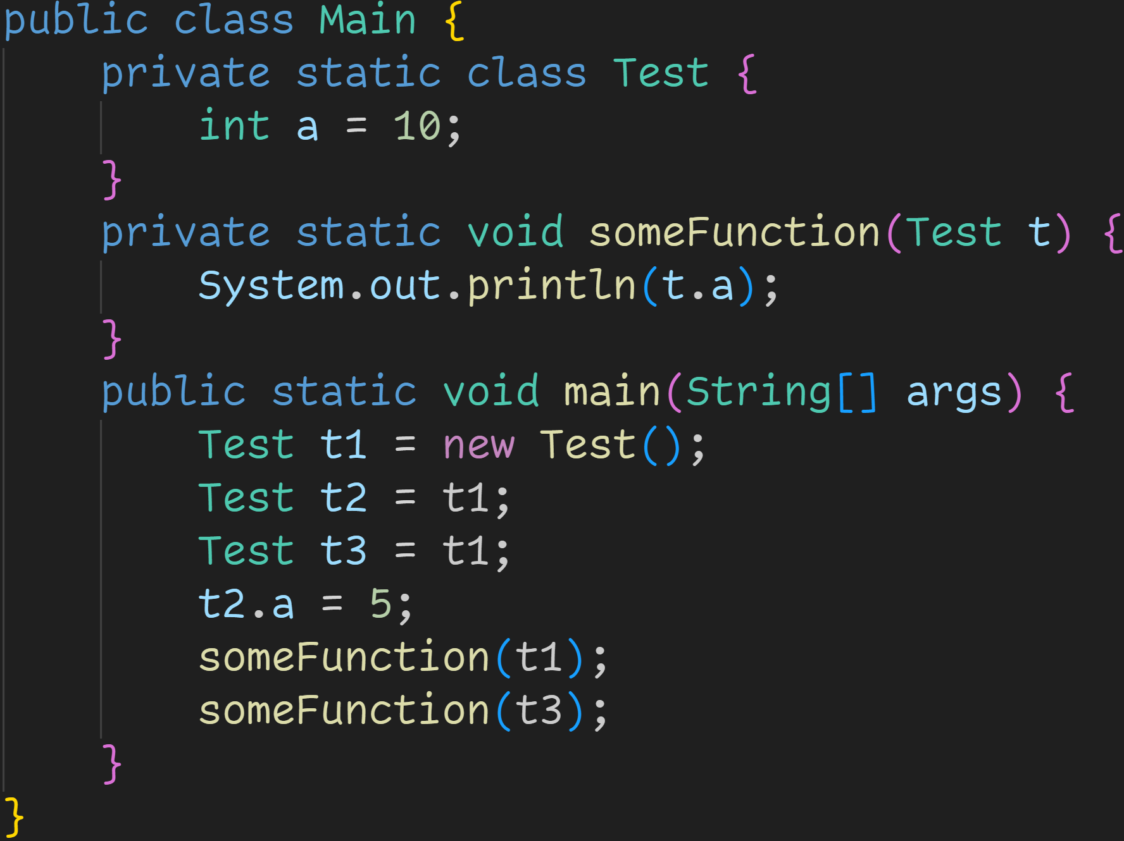

Slide 105
Object assignments in Java are references by default

Slide 106
Objects are initialized with .a = 10

Slide 107
Modifying t2 also modifies t1 and t3

Slide 108
Objects are initialized with .a = 10
→ Reasonable to expect t1.a=10
Prints 5 for both t1.a and t3.a!
Depending on the situation, you may not have wanted that!
Do something with t1 and t3

Slide 109
Borrow Checker
Rust is all about memory safety
References are powerful, but can also lead to all sorts of bugs if not treated carefully
Ask your local Java developer, he‘ll tell you a story or two
Ask your local Multithreading developer, he‘ll tell you a story or two

Slide 110
Borrow Checker
Rust is all about memory safety
References are powerful, but can also lead to all sorts of bugs if not treated carefully
Ask your local Java developer, he‘ll tell you a story or two
Ask your local Multithreading developer, he‘ll tell you a story or two
Race condition:
Multiple references access the same data at the same time
One reference writes data
At the same time, other reference reads data
Does it see the new value, or the old value?

Slide 111
Borrow Checker
Rust is all about memory safety
References are powerful, but can also lead to all sorts of bugs if not treated carefully
Race condition
To prevent this, Rust has the Borrow Checker

Slide 112
Borrow Checker
Rust is all about memory safety
References are powerful, but can also lead to all sorts of bugs if not treated carefully
Race condition
To prevent this, Rust has the Borrow Checker
Guarantees at compile time that no data races or race conditions happen

Slide 113
Borrow Checker
Rust is all about memory safety
References are powerful, but can also lead to all sorts of bugs if not treated carefully
Race condition
To prevent this, Rust has the Borrow Checker
Guarantees at compile time that no data races or race conditions happen
Set of rules that must be true at any point in your program

Slide 114
Borrow Checker
Rust is all about memory safety
References are powerful, but can also lead to all sorts of bugs if not treated carefully
Race condition
To prevent this, Rust has the Borrow Checker
Guarantees at compile time that no data races or race conditions happen
Set of rules that must be true at any point in your program
Reference mutably borrowed twice+ → Not allowed, illegal
Race condition: What happens if both write at the same time?

Slide 115
Borrow Checker
Rust is all about memory safety
References are powerful, but can also lead to all sorts of bugs if not treated carefully
Race condition
To prevent this, Rust has the Borrow Checker
Guarantees at compile time that no data races or race conditions happen
Set of rules that must be true at any point in your program
Reference mutably borrowed twice+ → Not allowed, illegal
Reference mutably borrowed once → No other references allowed, even immutable
Race condition

Slide 116
Borrow Checker
Rust is all about memory safety
References are powerful, but can also lead to all sorts of bugs if not treated carefully
Race condition
To prevent this, Rust has the Borrow Checker
Guarantees at compile time that no data races or race conditions happen
Set of rules that must be true at any point in your program
Reference mutably borrowed twice+ → Not allowed, illegal
Reference mutably borrowed once → No other references allowed, even immutable
Reference immutably borrowed → Only other immutable borrows allowed
Immutable borrow is readonly, 100 Reads don‘t change the value

Slide 117
Borrow Checker
Rust is all about memory safety
References are powerful, but can also lead to all sorts of bugs if not treated carefully
Race condition
To prevent this, Rust has the Borrow Checker
Guarantees at compile time that no data races or race conditions happen
Set of rules that must be true at any point in your program
Reference mutably borrowed twice+ → Not allowed, illegal
Reference mutably borrowed once → No other references allowed, even immutable
Reference immutably borrowed → Only other immutable borrows allowed
Reference may not outlive borrowed data
If the original value was dropped in the meantime, we‘d have dangling references

Slide 118
Borrow Checker
The Borrow Checker checks those rules by evaluating the lifetimes of references
Will be covered next week

Slide 119
Borrow Checker
The Borrow Checker checks those rules by evaluating the lifetimes of references
Will be covered next week
TLDR for now:
References only fall into those categories for the duration they‘re used

Slide 120
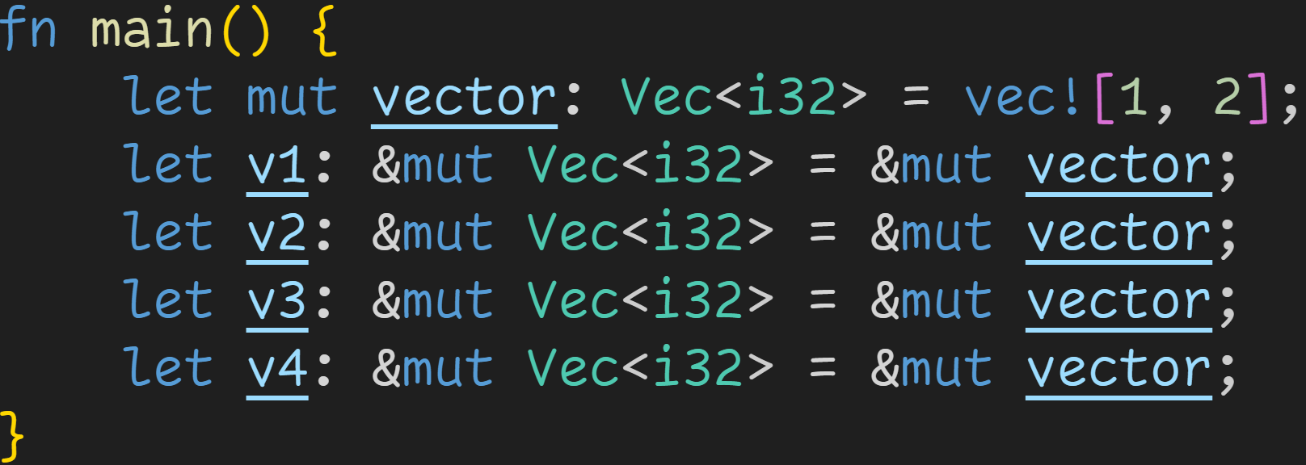
Borrow Checker

Slide 121
Borrow Checker
Even though we have 4 mutable references, it‘s fine because we‘re not doing anything with them!

Slide 122
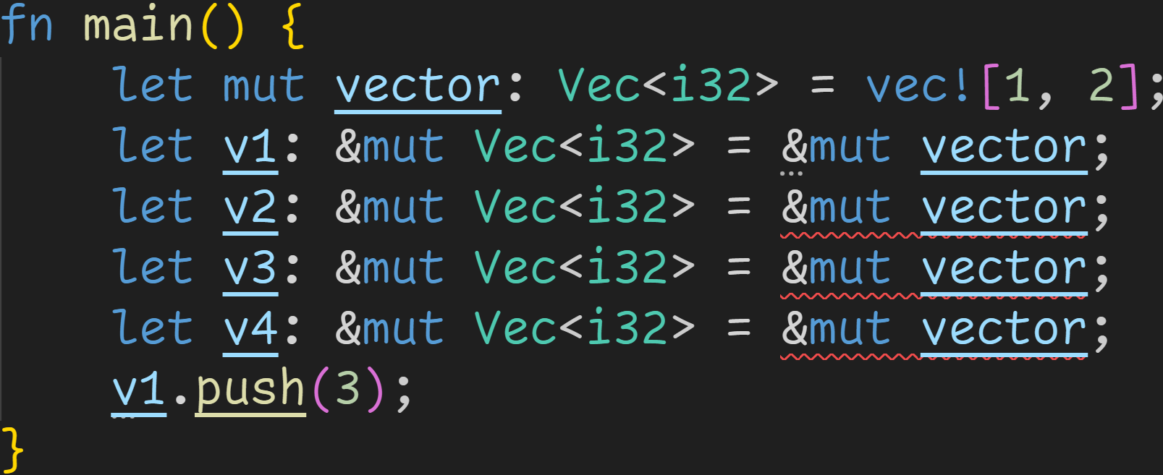
Borrow Checker

Slide 123
Borrow Checker
Mutable reference used in this range
→ No other references allowed here

Slide 124
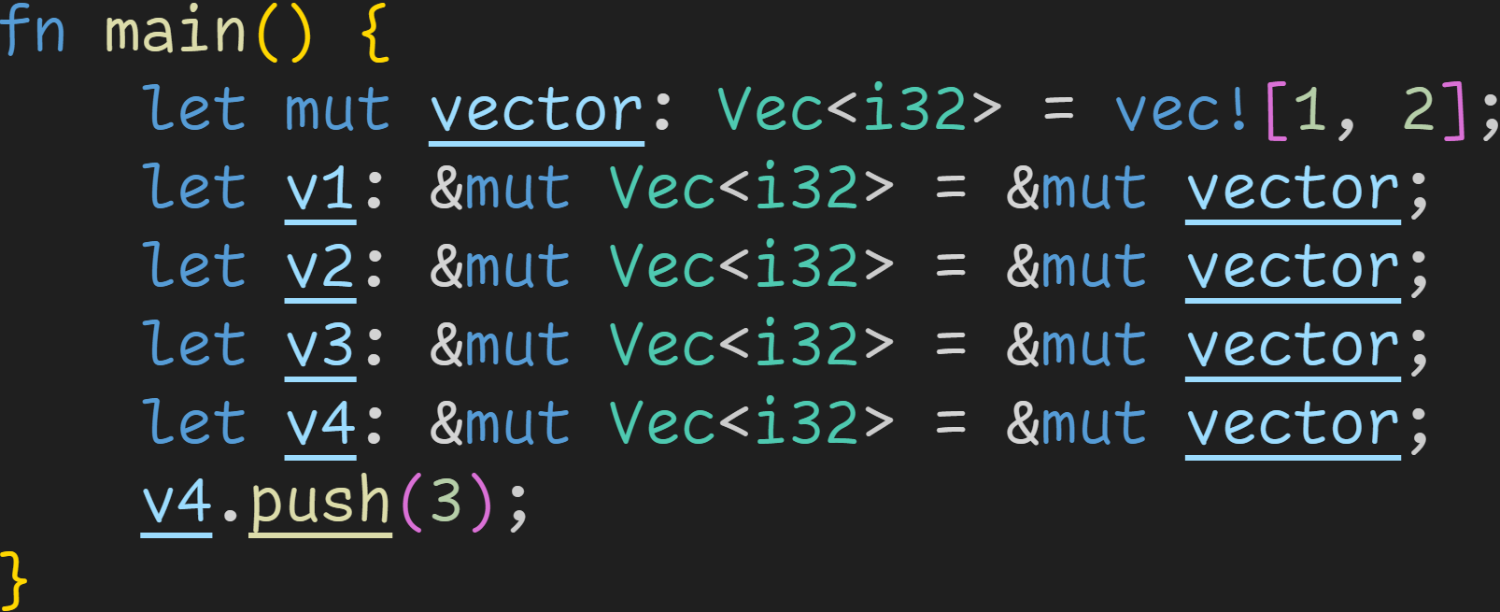
Borrow Checker

Slide 125
Borrow Checker
Mutable reference used in this range
→ No other references allowed here

Slide 126
Intermission - Exercises
Time for exercises!

Slide 127
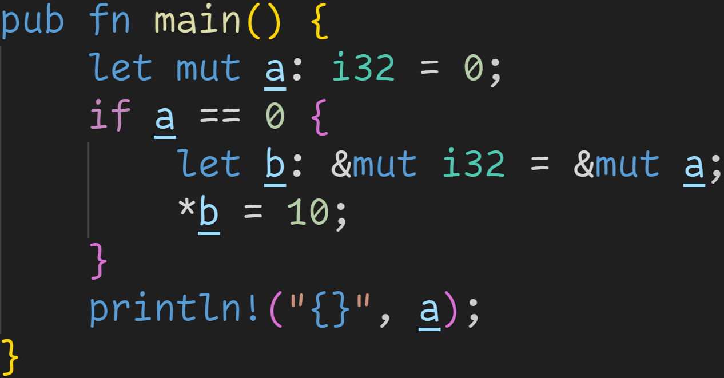
Intermission - Exercises
2/3

Slide 128
Intermission - Exercises
2/3
Does the code compile?
If yes, what does it print?

Slide 129
Intermission - Exercises
2/3
Does the code compile?
If yes, what does it print?
b contains the memory address of a

Slide 130
Intermission - Exercises
2/3
Does the code compile?
If yes, what does it print?
Dereference b
→ Get the original memory address → Gets address of a

Slide 131
Intermission - Exercises
2/3
Does the code compile?
If yes, what does it print?
Writes 10 into a

Slide 132

Intermission - Exercises
2/3
Does the code compile?
If yes, what does it print?
Writes 10 into a
It compiles, and prints:

Slide 133
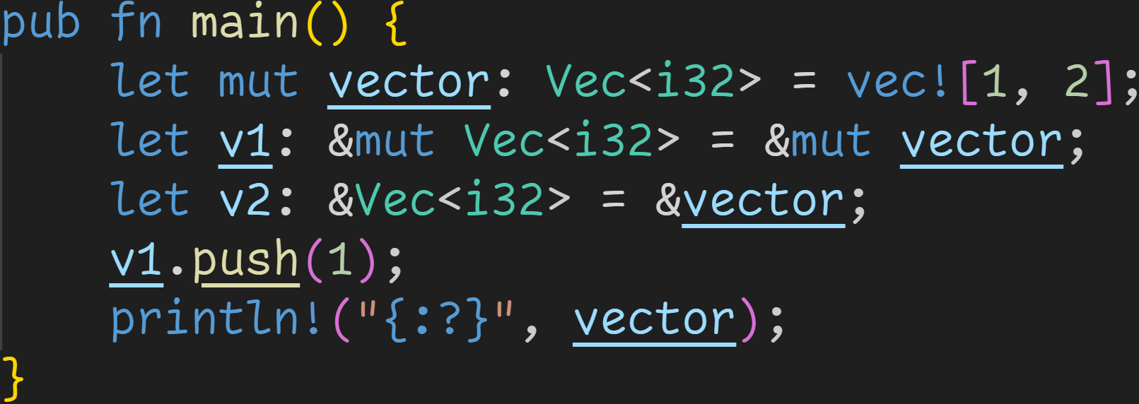
Intermission - Exercises
2/3

Slide 134
Intermission - Exercises
2/3
Does the code compile?
If yes, what does it print?

Slide 135
Intermission - Exercises
2/3
Does the code compile?
If yes, what does it print?
Mutable borrow here

Slide 136
Intermission - Exercises
2/3
Does the code compile?
If yes, what does it print?
Immutable borrow here
Mutable borrow here

Slide 137
Intermission - Exercises
2/3
Does the code compile?
If yes, what does it print?
Immutable borrow here
Mutable borrow here
Regions overlap
→ Borrow Checker violation
→ Code does not compile!

Slide 138
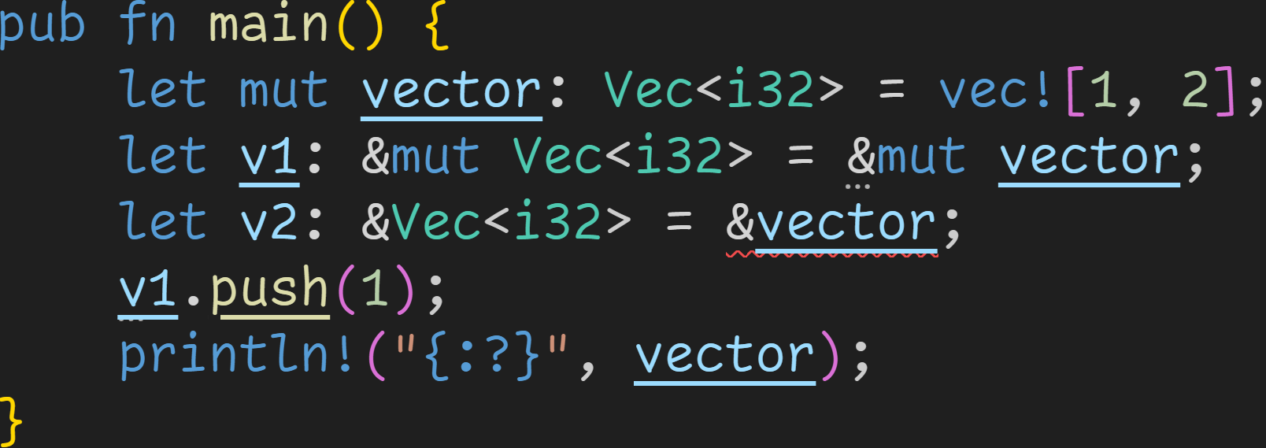
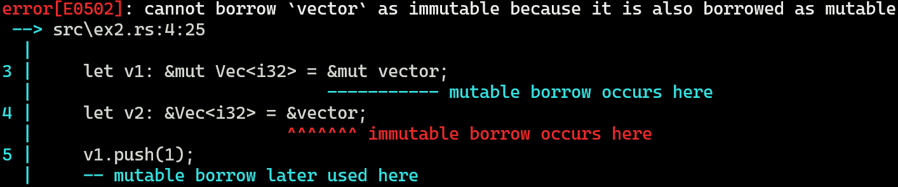
Intermission - Exercises
2/3

Slide 139
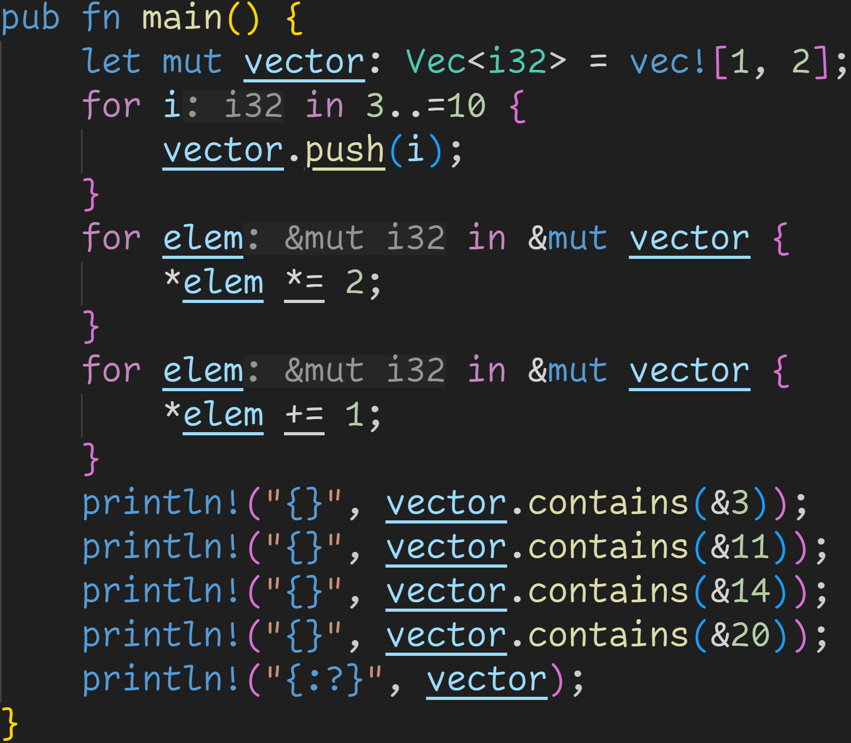
Intermission - Exercises
2/3

Slide 140
Intermission - Exercises
2/3
Does the code compile?
If yes, what does it print?

Slide 141
Intermission - Exercises
2/3
Does the code compile?
If yes, what does it print?
It does compile!

Slide 142
Intermission - Exercises
2/3
Does the code compile?
If yes, what does it print?
It does compile!
We‘re finally at a point where we can reuse the same Vector in a for-loop!

Slide 143
Intermission - Exercises
2/3
Does the code compile?
If yes, what does it print?
It does compile!
We‘re finally at a point where we can reuse the same Vector in a for-loop!
Those loops modify the elements of our original vector!

Slide 144
Intermission - Exercises
2/3
Does the code compile?
If yes, what does it print?
Mutable borrow in this range
Mutable borrow in this range

Slide 145
Intermission - Exercises
2/3
Does the code compile?
If yes, what does it print?
Mutable borrow in this range
No overlap → No Borrow Checker violation!
Mutable borrow in this range

Slide 146
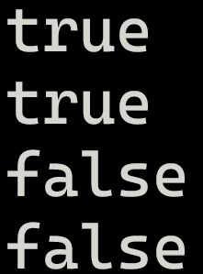
Intermission - Exercises
2/3
Does the code compile?
If yes, what does it print?

Slide 147
Intermission - Exercises
2/3
Does the code compile?
If yes, what does it print?

Slide 148
Next time
Lifetimes
Functions

